Slide 1

Video Game Sales Analysis: Technical
Date: 9/27/20
By: Bennett Holton

Slide 2
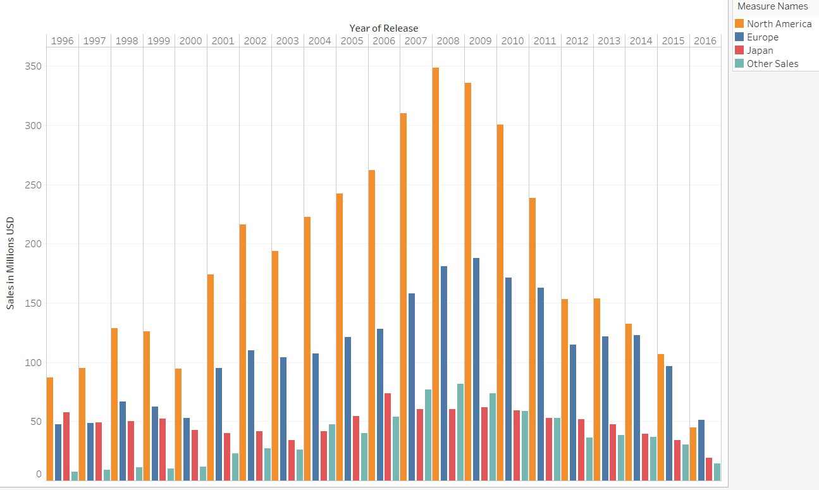
HYPOTHESIS: In the year 2021, video game profits will increase by 10% if the development team creates a game that has similarities to the style of previous top grossing games?
Video game sales over a 20-year period provide previous successful video game factors such as genre, rating, platform, region, and publishers to predict future video game profits.
Technical insights:
This graph is not to be analyzed by the projected growth of sales over years, but rather previous sales variables. Past records show trends indicative of a correlation to sale factors.
Estimation of increased profit comes from projected sales research from Grand View Research, which estimates Compound Annual Growth Rate (CAGR) of 12.9% from 2020 to 2027.
Key insights:
The new game must be an action or sport genre due to a 35% global market share.
Platforms that add a new element to the industry like VR can increase company sales as shown previously by 105%.
Video game needs to be E for everyone because they generate 40% of the market share.
The company need to partner with Nintendo who generates 38% more revenue in sales.
Game must be targeted to North America and Europe due to a 77% market share.
Video game sales over a 20-year period provide previous successful video game factors such as genre, rating, platform, region, and publishers to predict future video game profits.

Slide 3
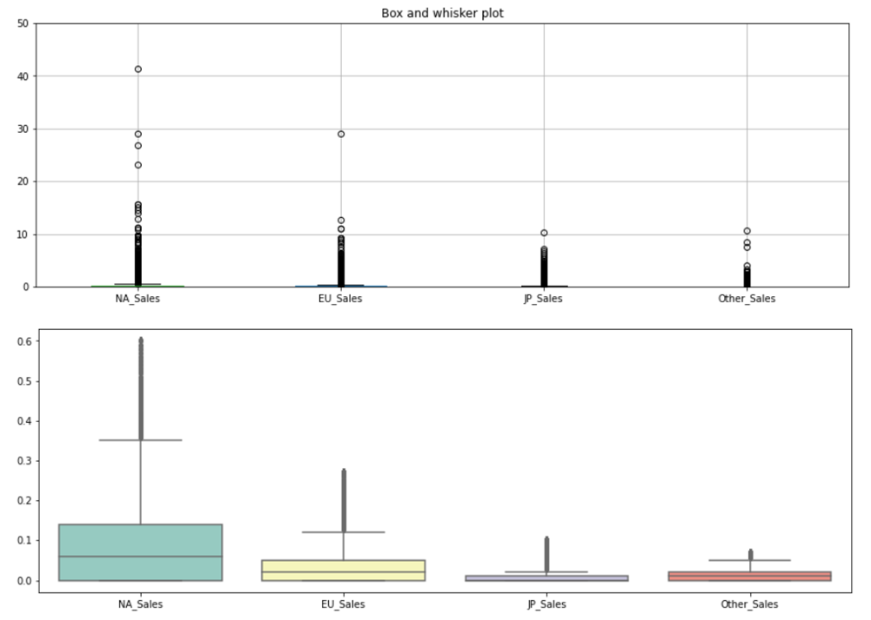
Background knowledge
The boxplots show the sales variations between each region.
Technical insights:
These plots show a significant amount of outliers beyond the IQR.
Outliers in this dataset are to be expected and contain useful information because the top performing outliers are needed to show why the sales were so high, which is what our hypothesis is trying to prove.
The average of sales in the dataset are under .06, which is represented as $60,000 USD. This means the median of the games are under performers.
Video game sales over a 20-year period provide previous successful video game factors such as genre, rating, platform, region, and publishers to predict future video game profits.

Slide 4
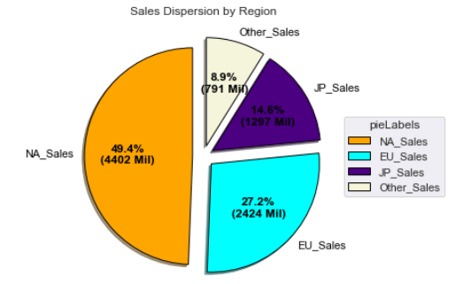
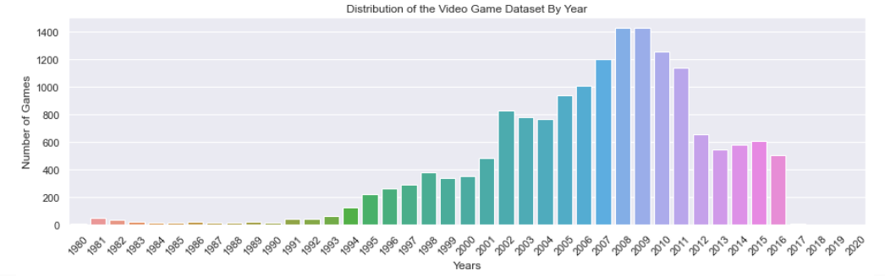
Background Knowledge
The distribution of the data is mainly in a 20-year window from 1996 to 2016 due to the gaps in the data. This is where the main insights come from in the dataset. Westernized markets need to be the focus of sales for the company and should be the target market for the next video game. Three key insights show that the westernized countries make up the largest percentage.
Key insights
The total market share in this dataset makes up 8.91 billion USD in sales which is also translated as "Global Sales".
Region of sales that should be targeted the most are North America and European sales which make up 76.6% of sales.
Due to the COVID-19 outbreak, North America is heavily effected, and the next developed game can increase video game sales by 35% (GameDaily.biz)
Video game sales over a 20-year period provide previous successful video game factors such as genre, rating, platform, region, and publishers to predict future video game profits.

Slide 5
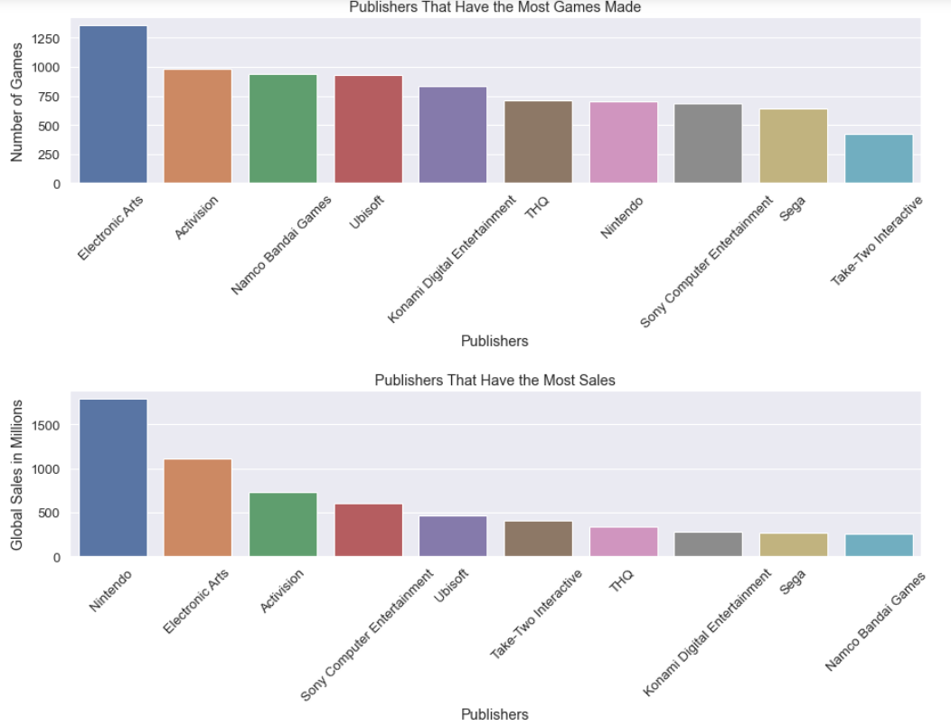
Background Knowledge
The company should partnership with Nintendo or Take-Two to develop the next video game based on past success.
Three key insights show that there is no correlation of profits to the volume of games produced.
Key insights
Nintendo can generate the company 38% more revenue than the second-best publisher because they make quality games and do not mass produce the quantity.
Take Two can generate the company 37% more revenue than Namco Bandai Games, even though Namco Bandai Games has 55% more games produced.
The next video game publisher the company partners with should be one like Nintendo that makes 1.9 million per game or Take-Two Interactive that makes .95 million per game (2 highest).
Video game sales over a 20-year period provide previous successful video game factors such as genre, rating, platform, region, and publishers to predict future video game profits.

Slide 6
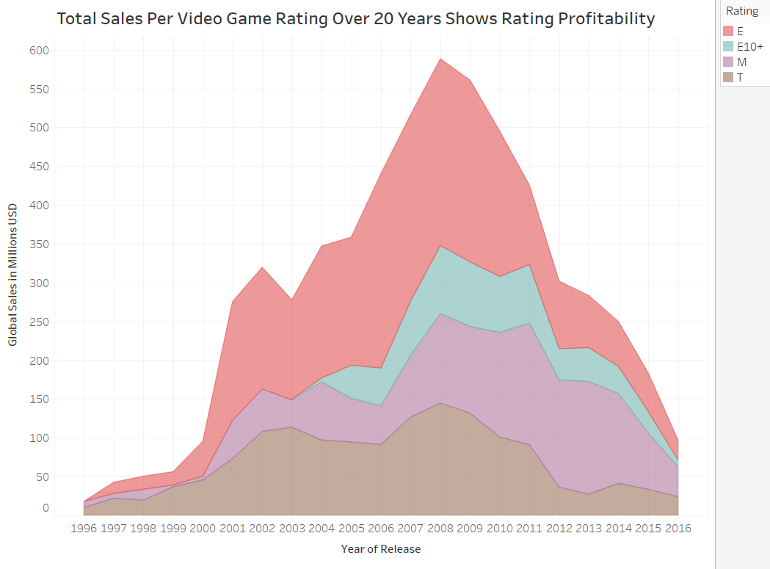
Background
The next game the company produces should have a large target market like E for everyone.
Three key insights that show the segmentation market is focused towards kids and adults.
Key insights
E for Everyone games are kid and adult friendly and have a market share of 40%, thus the company should focus on E for everyone development of the next game.
E10+ games should be avoided by the development team because they sell at a market share of 7%.
Mature and Teen games can be investigated in development, but the market share is lower by 16%, therefore they should not be the number one choice.
Video game sales over a 20-year period provide previous successful video game factors such as genre, rating, platform, region, and publishers to predict future video game profits.

Slide 7
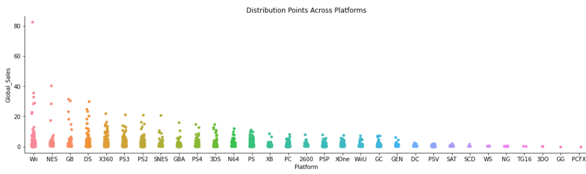
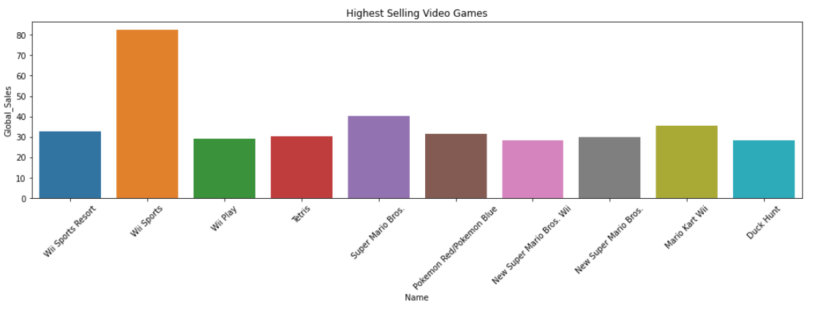
Background
New video game entertainment systems tend to sell the best due to their new capabilities and the development team should focus on virtual reality as that is a new capability as of late.
Three key insights that show novelty next generation video game consoles outperforming others.
Key insights
The PS2 had a video game market share of 14% of all video games in the dataset, due to the new functionality of a home theatre system built into the console.
The Wii is one of the first interactive consoles that is a novelty and 50% of the top 10 grossing games are by the Wii, thus meaning that new interactive consoles do well in game sales.
The Xbox 360 and PS3 are similar consoles that provided games with multiplayer capability with an expanded video game market resulting in a market share of 22% combined.
Video game sales over a 20-year period provide previous successful video game factors such as genre, rating, platform, region, and publishers to predict future video game profits.

Slide 8
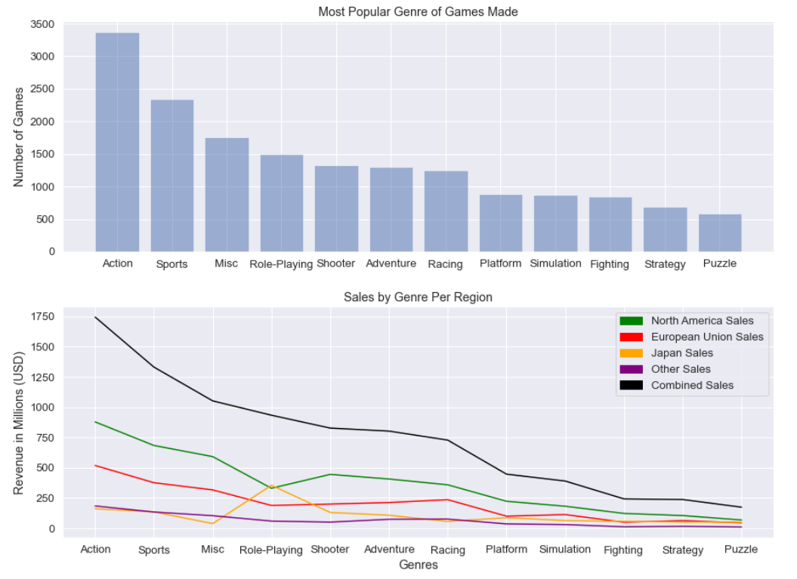
Background
Production of the next video game should be action or sports, due to the market share being significantly higher than the others. Three key insights that show action and sporting games should be the target genre.
Key insights
The genre that makes up most of the data set is action with 20% of the market share and the North American, European, and other sales reflect this with 20%, 22%, and 24% of sales respectively; and average of 20% overall exactly.
The second highest majority of the data set is sports with 14% of the market share and the North American, European, and other sales reflect this with 16%, 16%, and 17% of the sales respectively; and average of 15% overall exactly.
The reason action and sport genres have a low overall average is due to Japan grossing the most sales from role-playing games. The total market share in Japan for role playing games is 28% in this data set, with action and sport genres ranked 2nd (13%) and 3rd (11%) respectively.
Video game sales over a 20-year period provide previous successful video game factors such as genre, rating, platform, region, and publishers to predict future video game profits.

Slide 9
These factors will help drive sales in 2021 above 10%:
Target the European and North American markets especially with the Covid-19 factors due to a 76.7% market share.
Partner with Nintendo or Take-Two to make the next top seller, which gross 2 million and 1 million per game, respectively.
Create a game that is E for everyone should be priority with a 40% market share.
Create a new game that on a revolutionary platform like Wii Sports which is 105% more revenue than any other game due to its interactive capabilities not seen before in gaming.
Create a game that is either an action or sports genre because their market share is 20% and 15% respectively.
Video game sales over a 20-year period provide previous successful video game factors such as genre, rating, platform, region, and publishers to predict future video game profits.

